Slide 1
Optimally Solving Rubik’s Cube with Pattern Databases
Adam Hayse

Slide 2
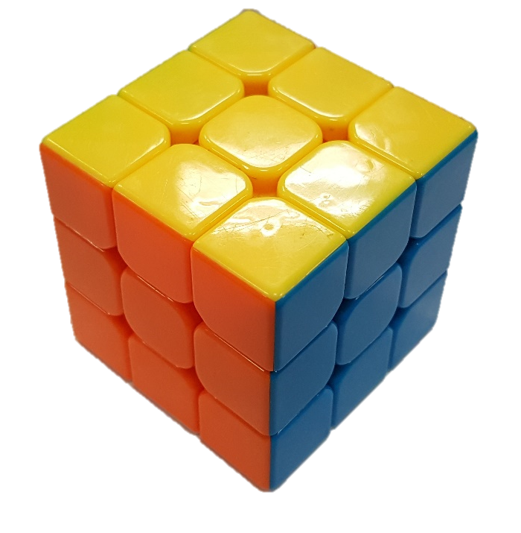
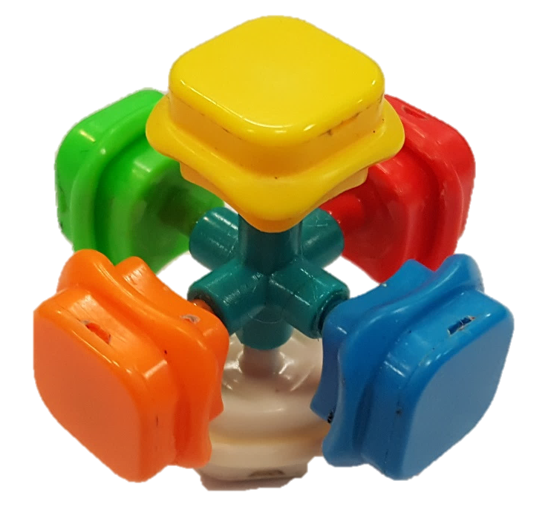
What is a Rubik’s Cube?
3-dimensional combination puzzle with 43,252,003,274,489,856,000 solvable states.
The objective is to turn the faces in order to make each face the same color.
Pealing off the stickers and putting them back on is not allowed.
Notes:
Most people are familiar with the general idea behind the Rubik’s Cube because of its association with popular culture.

Slide 3
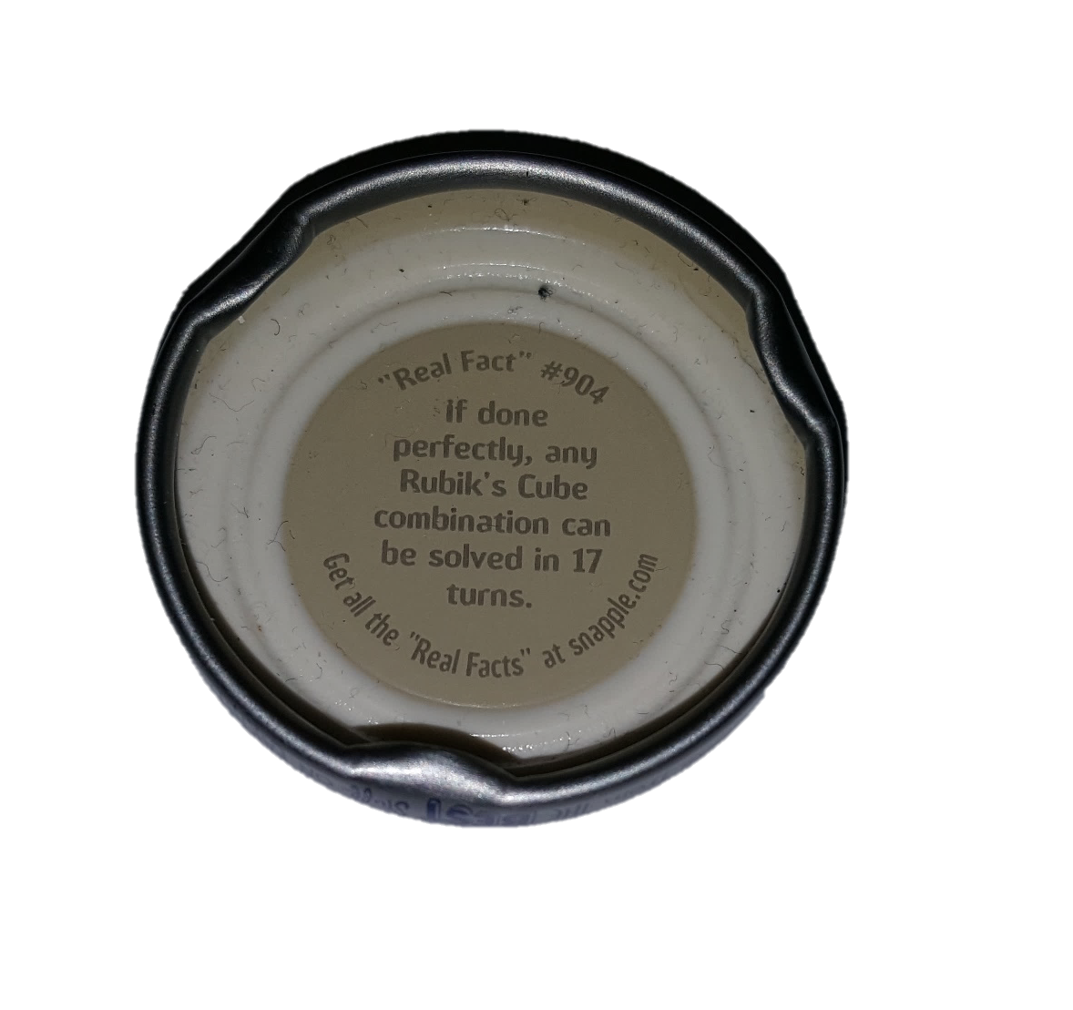
Turn Metric
There are many metrics for defining what counts as a move.
Half Turn Metric
Quarter Turn Metric
Slice Turn Metric
For this application, I use the half turn metric.
In 2010, God’s number was shown to be 20 using the half turn metric.

Slide 4
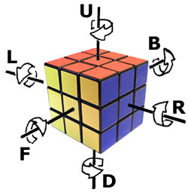
Notation
U – Upper
F – Front
L – Left
B – Back
R – Right
D - Down
U – Turn Upper Face 90° Clockwise
U2 – Turn Upper Face 180°
U’ – Turn Upper Face 90° Counter-clockwise
Example set of moves:
R U R’ U’

Slide 5
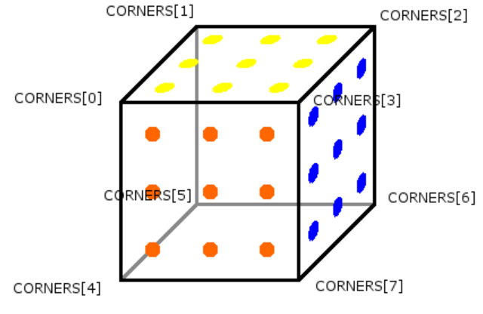
Representing the cube in memory
Cubie 1 YOG 0 GYO 1 OGY 2
Cubie 2 YGR 3 RYG 4 GRY 5
Cubie 3 YRB 6 BYR 7 RBY 8
Cubie 4 YBO 9 OYB 10 BOY 11
Cubie 5 WGO 12 OWG 13 GOW 14
Cubie 6 WRG 15 GWR 16 RGW 17
Cubie 7 WBR 18 RWB 19 BRW 20
Cubie 8 WOB 21 BWO 22 OBW 23
Yellow face is Up, Orange face is Front
Solved corners:
CORNERS = {0, 3, 6, 9, 12, 15, 18, 21}

Slide 6
Heuristics
3D Manhattan distance
Sum up the number of moves needed to move every piece into its solved position with correct orientation.
Divide this value by 8 because each move affects 4 edges and 4 corners.
Pattern database
Find the minimum number of moves needed to solve a set of pieces from any given position.
Sets of pieces:
All corners: 8! x 3⁷ = 88,179,840 solvable combinations
6 of the 12 edges: 12!/6! x 2⁶ = 42,577,920 solvable combinations
Remaining 6 edges: 12!/6! x 2⁶ = 42,577,920 solvable combinations
Notes:
3D Manhattan distance – Look at each individual movable piece and find the minimum number of moves to put it into its correct position and orientation. Sum up all of these values. In order for this heuristic to be admissible, it has to be divided by 8 because every move moves 4 edges and 4 corners.

Slide 7
Making the Pattern Database
Perform a breadth-first search from the solved state.
Only expand states that haven’t been visited.
All moves have the same cost, so breadth-first search finds the shortest path from the solution state to any reachable combination.
This also means that the shortest path is also found from any valid combination to the solved state.

Slide 8
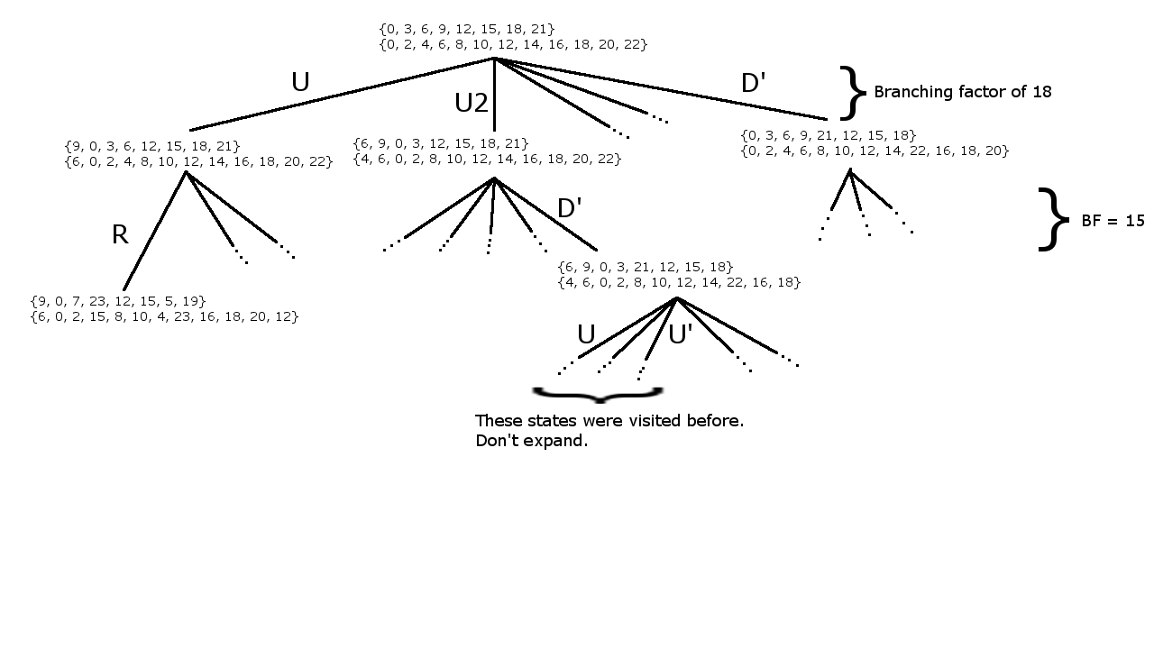

Slide 9
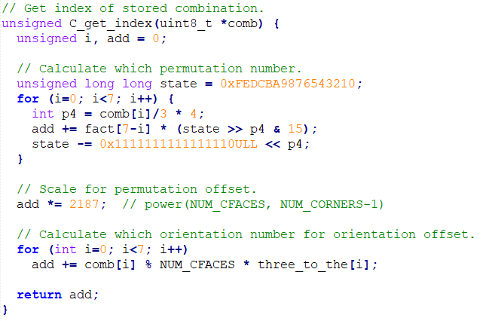
Encode function
Need a function that turns a set of pieces into an index in a database.
Solved state:
C_get_index({0, 3, 6, 9, 12, 15, 18, 21}) = 0
From solved state, turn U:
C_get_index({9, 0, 3, 6, 12, 15, 18, 21}) = 33067440
From solved state, turn U2:
C_get_index({6, 9, 0, 3, 12, 15, 18, 21}) = 25194240

Slide 10
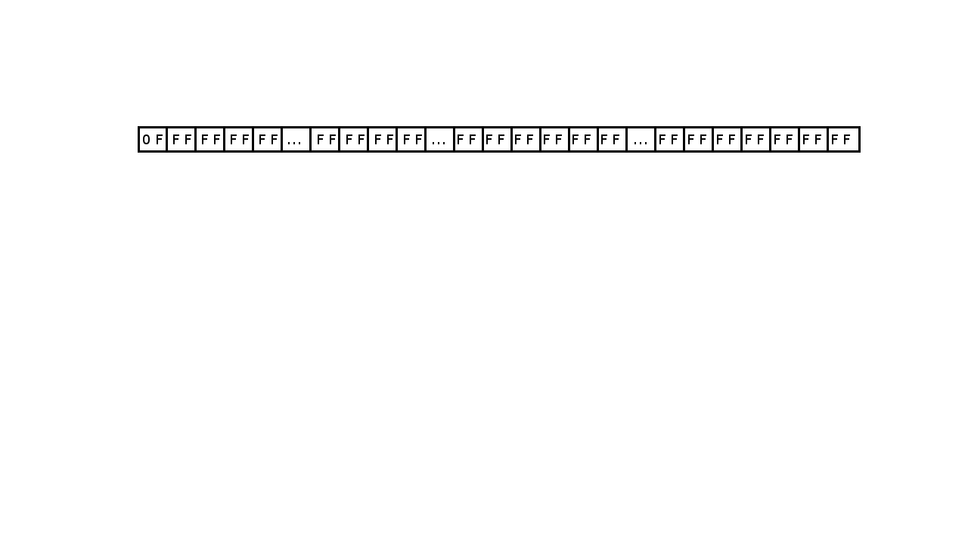

Slide 11
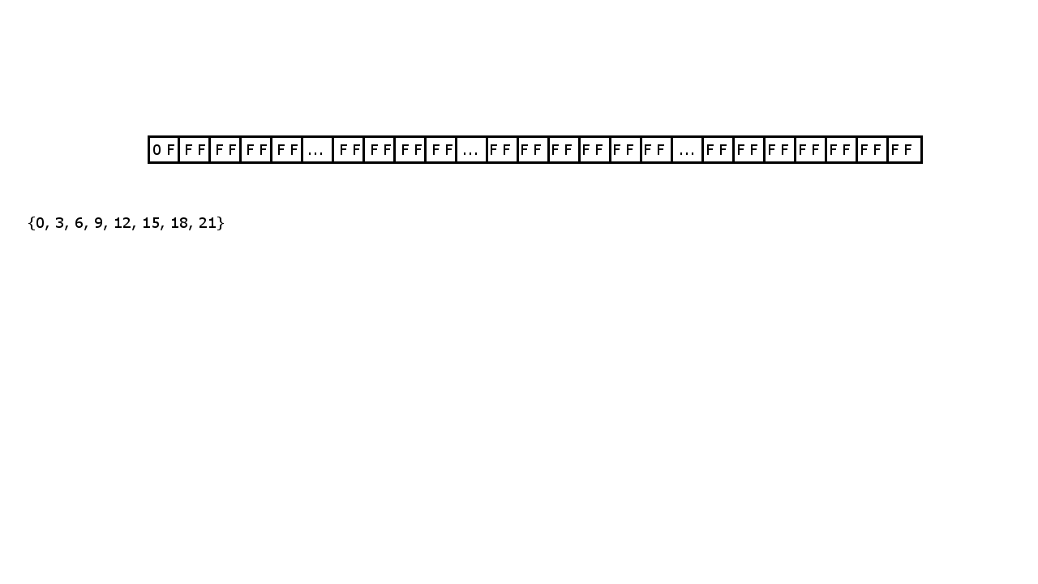

Slide 12
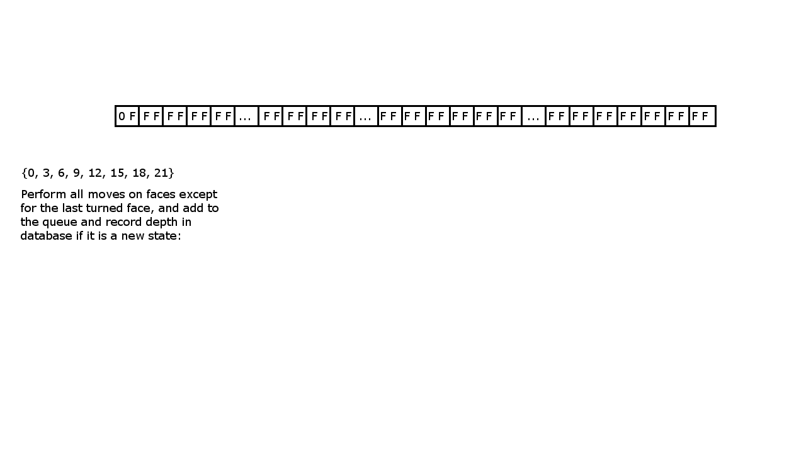

Slide 13
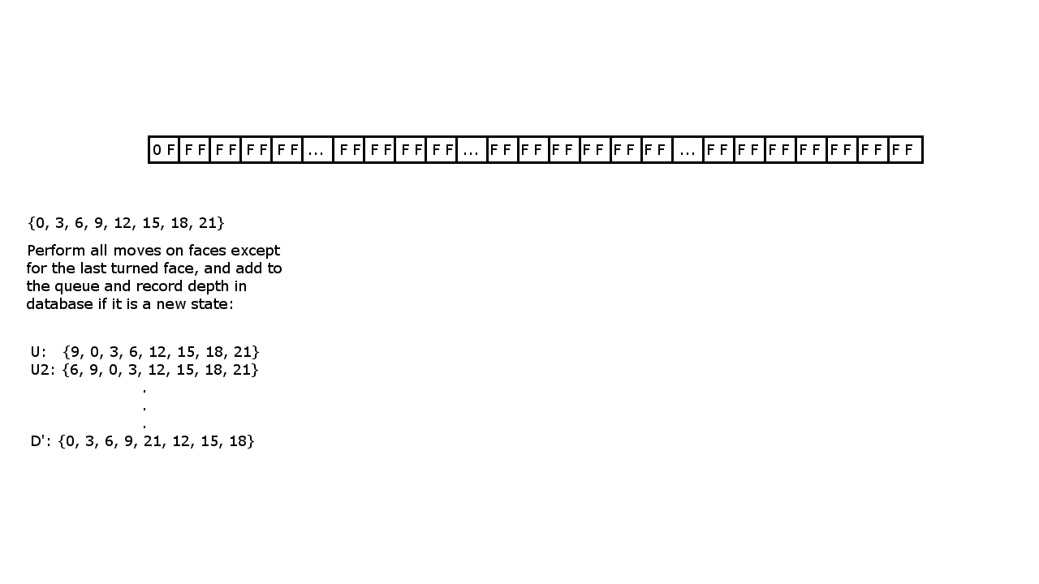

Slide 14
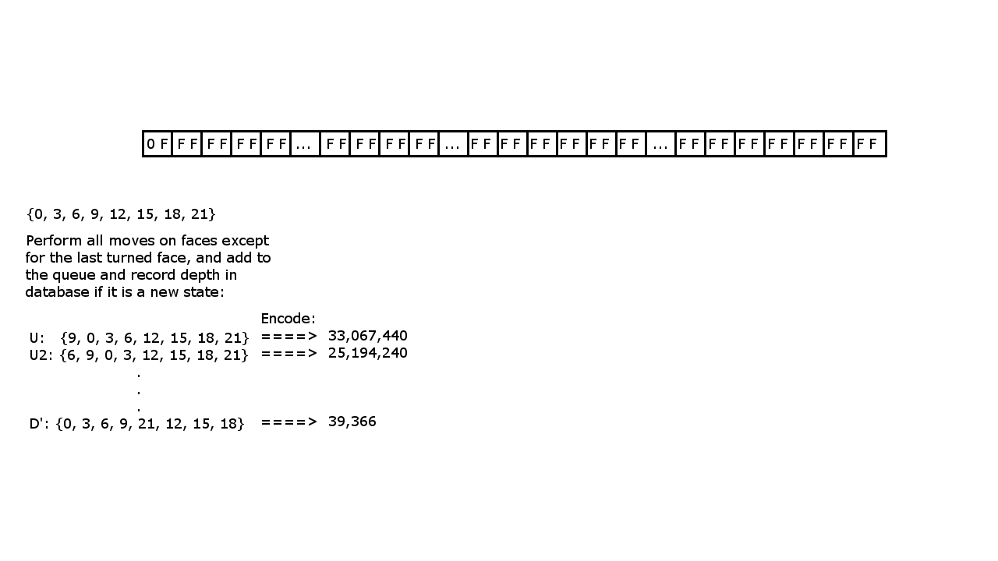

Slide 15
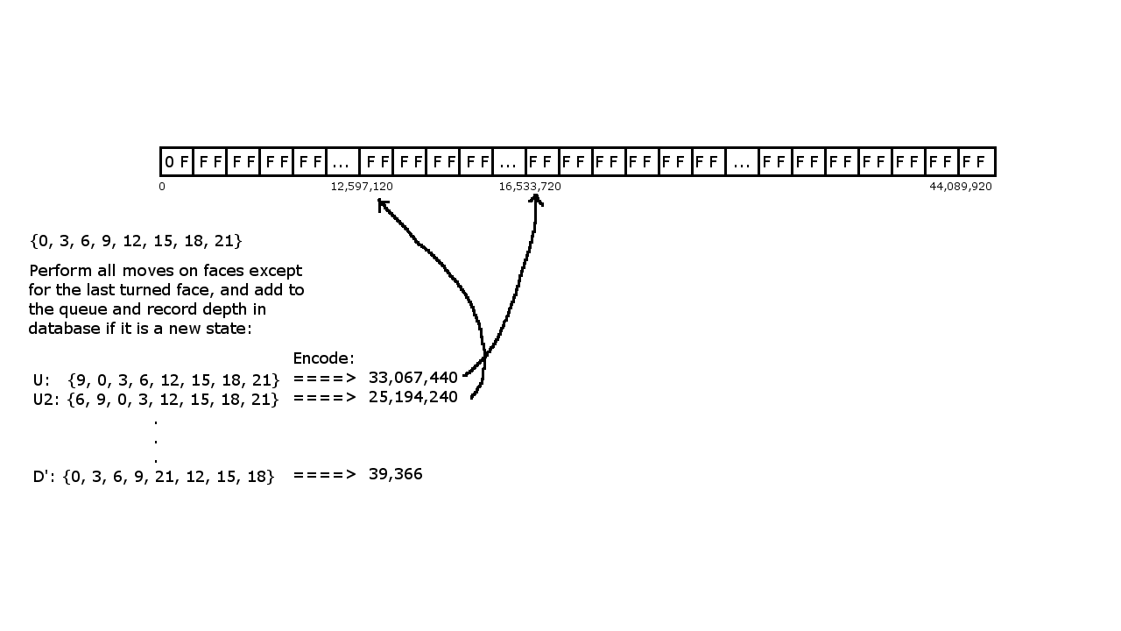

Slide 16


Slide 17
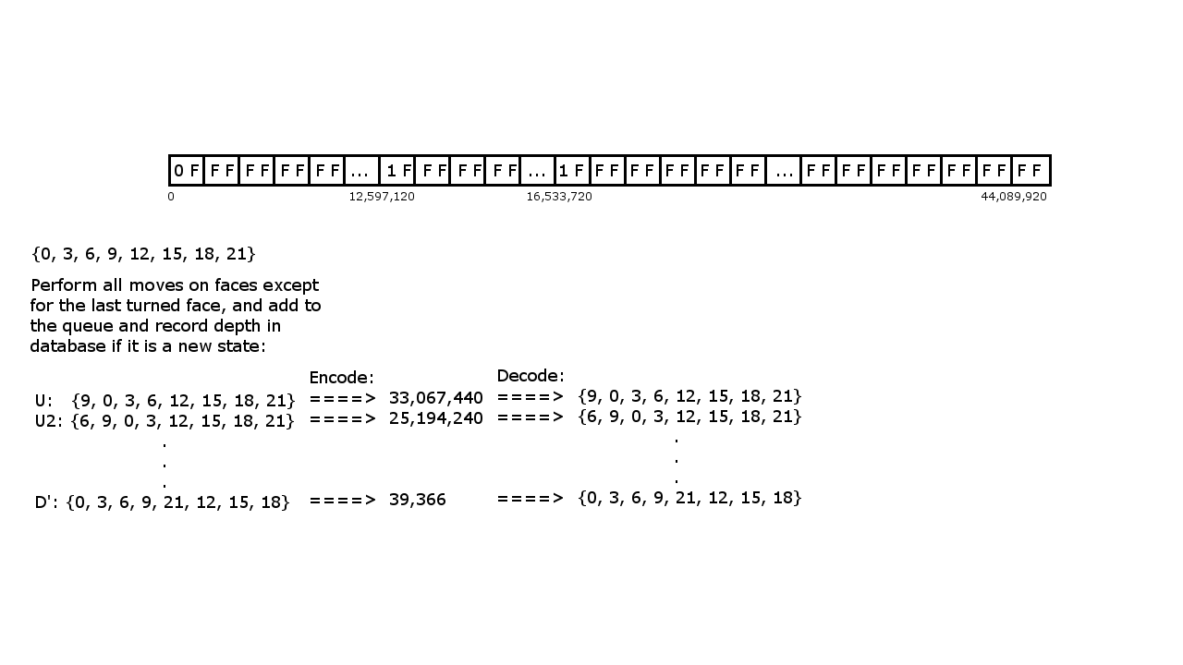

Slide 18
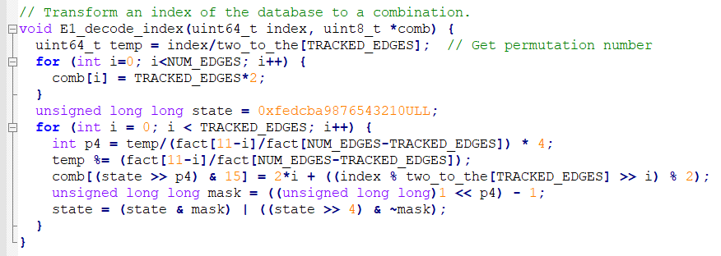
Decode function

Slide 19
Pattern Database Results
 | Corner DB | 42.05 | MiB
 |  | Number of moves from solved state | Number of states
 | 0.0000011% | 0 | 1 | 0
 | 0.0000204% | 1 | 18 | 18
 | 0.0002756% | 2 | 243 | 486
 | 0.0032592% | 3 | 2874 | 8622
 | 0.0317533% | 4 | 28000 | 112000
 | 0.2329512% | 5 | 205416 | 1027080
 | 1.3251510% | 6 | 1168516 | 7011096
 | 6.1268290% | 7 | 5402628 | 37818396
 | 23.5611405% | 8 | 20776176 | 166209408
 | 51.4761832% | 9 | 45391616 | 408524544
 | 17.1690219% | 10 | 15139616 | 151396160
 | 0.0734136% | 11 | 64736 | 712096
 |  |  | 88179840 | 772819906
 |  |  |  | 8.76413368 | average heuristic

Slide 20
Pattern Database Results
 | 6 Edge DB | 20.30 | MiB
 |  | Number of moves from solved state | Number of states
 | 0.0000023% | 0 | 1 | 0
 | 0.0000352% | 1 | 15 | 15
 | 0.0004275% | 2 | 182 | 364
 | 0.0051858% | 3 | 2208 | 6624
 | 0.0594886% | 4 | 25329 | 101316
 | 0.6078902% | 5 | 258827 | 1294135
 | 5.0861104% | 6 | 2165560 | 12993360
 | 28.7066818% | 7 | 12222708 | 85558956
 | 57.7687966% | 8 | 24596752 | 196774016
 | 7.7645244% | 9 | 3305973 | 29753757
 | 0.0008573% | 10 | 365 | 3650
 |  |  | 42577920 | 326486193
 |  |  |  | 7.667969525 | average heuristic

Slide 21
Pattern Database Results
 | 7 Edge DB | 243.63 | MiB
 |  | Number of moves from solved state | Number of states
 | 0.0000002% | 0 | 1 | 0
 | 0.0000029% | 1 | 15 | 15
 | 0.0000374% | 2 | 191 | 382
 | 0.0004805% | 3 | 2455 | 7365
 | 0.0059732% | 4 | 30519 | 122076
 | 0.0697666% | 5 | 356462 | 1782310
 | 0.7372170% | 6 | 3766700 | 22600200
 | 6.4038409% | 7 | 32719467 | 229036269
 | 36.4619755% | 8 | 186297009 | 1490376072
 | 53.7680158% | 9 | 274719633 | 2472476697
 | 2.5526742% | 10 | 13042507 | 130425070
 | 0.0000159% | 11 | 81 | 891
 |  |  | 510935040 | 4346827347
 |  |  |  | 8.507592955 | average heuristic

Slide 22
Pattern Database Results
 | 8 Edge DB | 2436.33 | MiB
 |  | Number of moves from solved state | Number of states
 | 0.000000020% | 0 | 1 | 0
 | 0.000000294% | 1 | 15 | 15
 | 0.000003875% | 2 | 198 | 396
 | 0.000051474% | 3 | 2630 | 7890
 | 0.000666093% | 4 | 34033 | 136132
 | 0.008290154% | 5 | 423573 | 2117865
 | 0.097858546% | 6 | 4999936 | 29999616
 | 1.051052870% | 7 | 53701974 | 375913818
 | 9.202244399% | 8 | 470174911 | 3761399288
 | 48.255789699% | 9 | 2465557384 | 22190016456
 | 41.073059992% | 10 | 2098566555 | 20985665550
 | 0.310982253% | 11 | 15889173 | 174780903
 | 0.000000333% | 12 | 17 | 204
 |  |  | 5109350400 | 47520038133
 |  |  |  | 9.300602701 | average heuristic

Slide 23
Database for the entire cube
2.28839E-20 | 0 | 1 | 0
4.11909E-19 | 1 | 18 | 18
5.56078E-18 | 2 | 243 | 486
7.41437E-17 | 3 | 3240 | 9720
9.89475E-16 | 4 | 43239 | 172956
1.31561E-14 | 5 | 574908 | 2874540
1.74339E-13 | 6 | 7618438 | 45710628
2.30676E-12 | 7 | 100803036 | 705621252
3.04892E-11 | 8 | 1332343288 | 1.0659E+10
4.02675E-10 | 9 | 17596479795 | 1.5837E+11
5.31473E-09 | 10 | 2.32248E+11 | 2.3225E+12
7.00999E-08 | 11 | 3.06329E+12 | 3.3696E+13
9.23923E-07 | 12 | 4.03744E+13 | 4.8449E+14
1.21663E-05 | 13 | 5.31653E+14 | 6.9115E+15
0.000159943 | 14 | 6.98932E+15 | 9.785E+16
0.002090787 | 15 | 9.13651E+16 | 1.3705E+18
0.025172241 | 16 | 1.1E+18 | 1.76E+19
0.274606267 | 17 | 1.2E+19 | 2.04E+20
0.663631813 | 18 | 2.9E+19 | 5.22E+20
0.034325783 | 19 | 1.5E+18 | 2.85E+19
1.12131E-11 | 20 | 490000000 | 9800000000
 |  | 4.36989E+19 | 7.7358E+20
 |  |  | 17.702396 | average heuristic

Slide 24
Heuristic Search Algorithm
A*
Time efficiency – exponential
Space efficiency – exponential
Iterative deepening A*
Time efficiency – exponential
Space efficiency – O(bd)

Slide 25
Demo
18 move scramble: B2 F' L2 B D U' L' R' U2 L D' L' U R' F2 B U2 R’
18 move solution: U R' B' U L F U' B' L' B2 R2 F' U' L F R2 U L
17 move scramble: L' B' R' B2 U2 L2 U2 L F' R F2 U' L' F' R' B D’
17 move solution: B' R F L U' F U2 D' F2 L2 R' F B R U' B2 R2

Slide 26
References
Rokicki, Tomas, et al. “God's Number Is 20.” God's Number Is 20, www.cube20.org/.
Korf, Richard E. “Finding Optimal Solutions to Rubik's Cube Using Pattern Databases.” Https://Www.cs.princeton.edu, www.cs.princeton.edu/courses/archive/fall06/cos402/papers/korfrubik.pdf.
Clausecker, Robert. “Notes on the Construction of Pattern Databases.” OPUS 4, Zuse Institute Berlin, Nov. 2017, opus4.kobv.de/opus4-zib/frontdoor/index/index/docId/6558.

